Slide 1
Amphibolic Activity of Amino Acids

Slide 2
Certain amino acids serve as precursors of many kinds of small molecules that have important and diverse biological roles, eg.,
  Hormones,
  Coenzymes,
  Nucleotides,
  Alkaloids,
  Cell-wall polymers,
  Porphyrins,
  Antibiotics,
  Pigments, and neurotransmitters

Slide 3
Glycine is a precursor of porphyrins
Glycine being the major precursor has the central importance beause of the porphyrin nucleus in heme proteins such as hemoglobin and the cytochromes
Porphyrins constructed from four molecules of porphobilinogen, which itself is derived from two molecules of aminolevulinate
There are two major pathways to Aminolevulinate
Biosynthesis is regulated in higher eukaryotes by the concentration of the heme product, which serves as a feedback inhibitor
Genetic defects in synthesis of porphyrins can lead to the accumulation of pathway intermediates, causing a variety of human diseases known collectively as porphyrias

Slide 4
Introduction to Heme
Heme provides the iron- porphyrin group of hemoglobin
It is the source of bile pigment
It is degraded by two pathways
When hemoglobin in erythrocytes are degraded in spleen, heme is released
Heme is converted to biliverdin and finally to bilirubinn in the liver
The precursor is synthesized from Succinyl Co-A and glycine in higher eukaryotes
In plants algae and bacteria, the precursor for heme is synthesized from glutamate

Slide 5
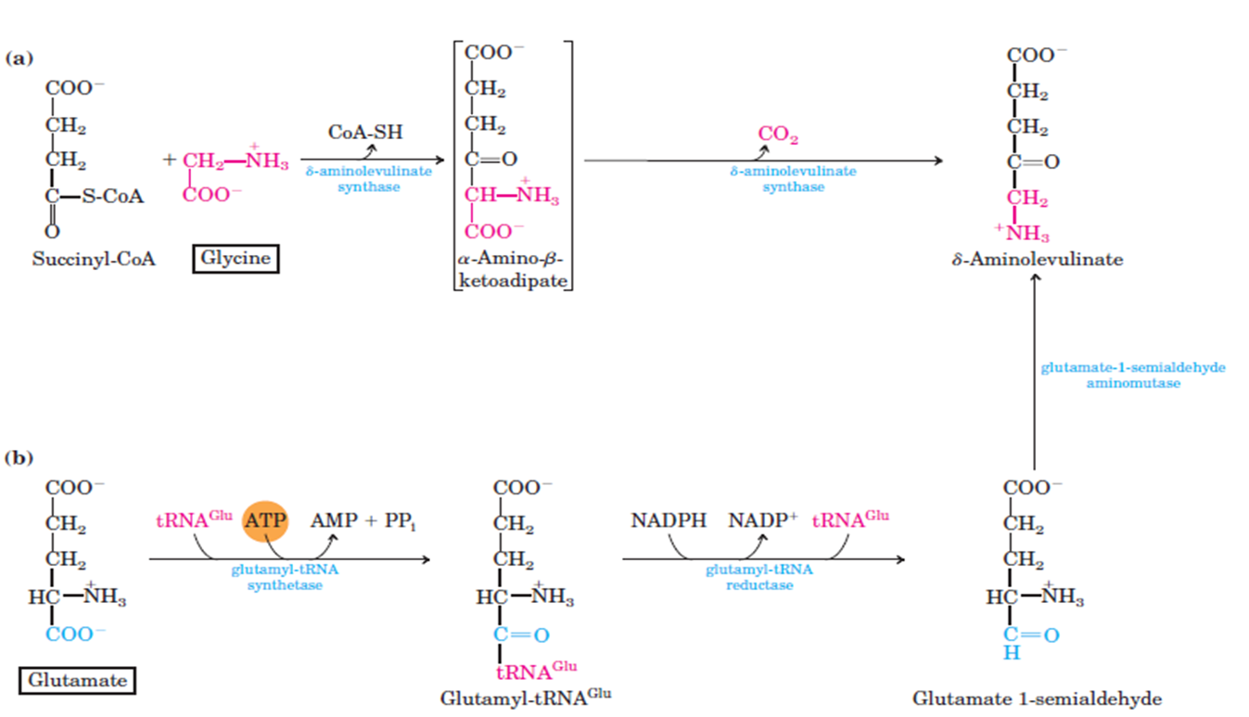
Biosynthesis of precursor of Heme (Aminolevulinate)

Slide 6
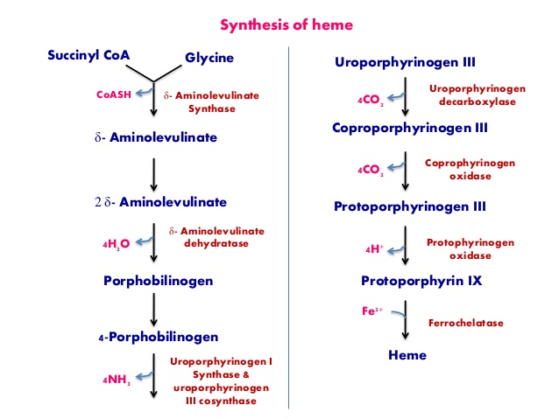
Biosynthesis of Heme from Aminolevulinate

Slide 7
Amino Acids Are Precursors of Creatine
Phosphocreatine, derived from creatine, is an important energy buffer in skeletal muscle
Creatine is synthesized from glycine and arginine methionine, in the form of S-adenosylmethionine, acts as methyl group donor

Slide 8
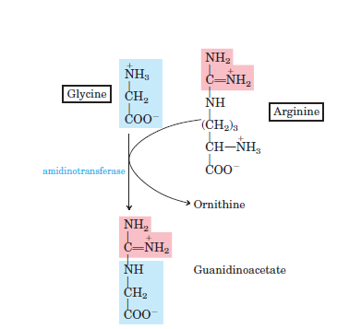
Biosynthesis of creatine and phosphocreatine

Slide 9
Amino Acids Are Precursors of Glutathione
Glutathione are mostly present in plants, animals, and some bacteria, can be considered as a redox buffer.
It is derived from glycine, glutamate, and cysteine.
The carboxyl group of glutamate is activated by ATP to form an acyl phosphate.

Slide 10
Glutathione probably helps maintain the sulfhydryl groups of proteins in the reduced state and the iron of heme in the ferrous (Fe₂) state, and it serves as a reducing agent for glutaredoxin in deoxyribonucleotide synthesis.
Its redox function is also used to remove toxic peroxides formed under aerobic conditions.
This reaction is catalyzed by glutathione peroxidase.

Slide 11
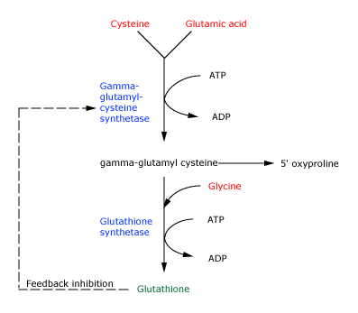
Glutathione metabolism

Slide 12
Precursors of Many Plant Substances
Phenylalanine, tyrosine, and tryptophan are converted to a variety of important compounds in plants
Tryptophan is also the precursor of the plant growth hormone indole-3-acetate.
Phenylalanine and tyrosine also give rise to many commercially significant natural products such as morphine, flavouring of cinnamon oil , nutmeg, cloves, vanilla, cayenne pepper, and other products.

Slide 13
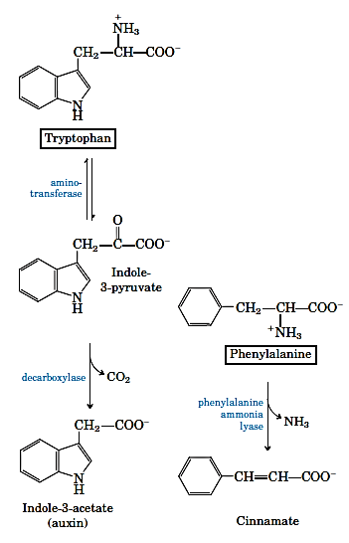
Biosynthesis of plant substances from amino acids

Slide 14
Biological Amines Are Products of Amino Acid Decarboxylation
Many important neurotransmitters are primary or secondary amines
Tyrosine gives rise to a family of catecholamines that includes dopamine, norepinephrine, and epinephrine.
The neurological disorder Parkinson’s disease is associated with an underproduction of dopamine.

Slide 15
Glutamate decarboxylation gives rise to aminobutyrate (GABA), an inhibitory neurotransmitter
Polyamines such as spermine and spermidine, involved in DNA packaging, are derived from methionine and ornithine
Ornithine decarboxylase, a PLP-requiring enzyme, is the target of several powerful inhibitors used as pharmaceutical agents

Slide 16
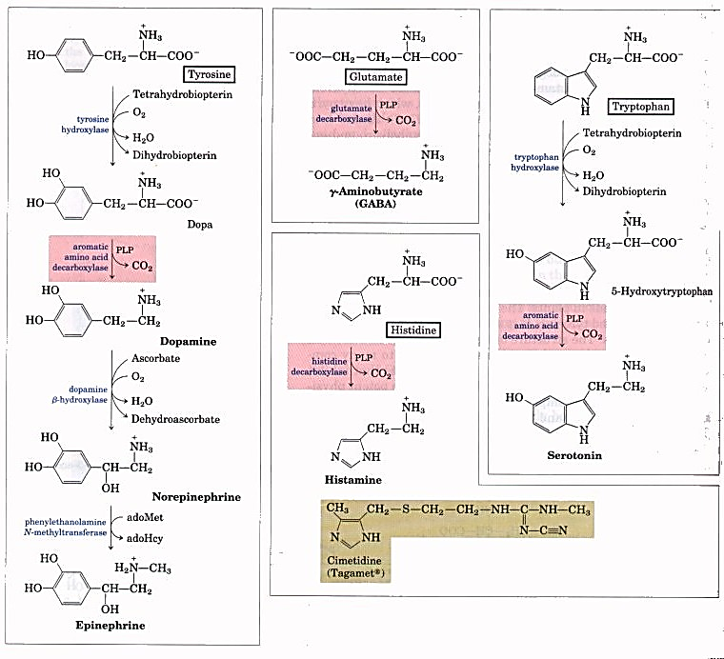

Slide 17
Arginine Is the Precursor for Biological Synthesis of Nitric Oxide
Role of nitric oxide (NO) acts as an important biological messenger.
This simple gaseous substance diffuses readily through membranes.
In humans NO plays a role in a range of physiological processes, including neurotransmission, blood clotting etc.
Nitric oxide is synthesized from arginine in an NADPH-dependent reaction catalyzed by nitric oxide synthase.

Slide 18
Each subunit of the enzyme contains one bound molecule of each of four different cofactors: FMN, FAD, tetrahydrobiopterin, and Fe₃ heme.
NO is an unstable molecule and cannot be stored.
Its synthesis is stimulated by interaction of nitric oxide synthase with Ca2-calmodulin.

Slide 19
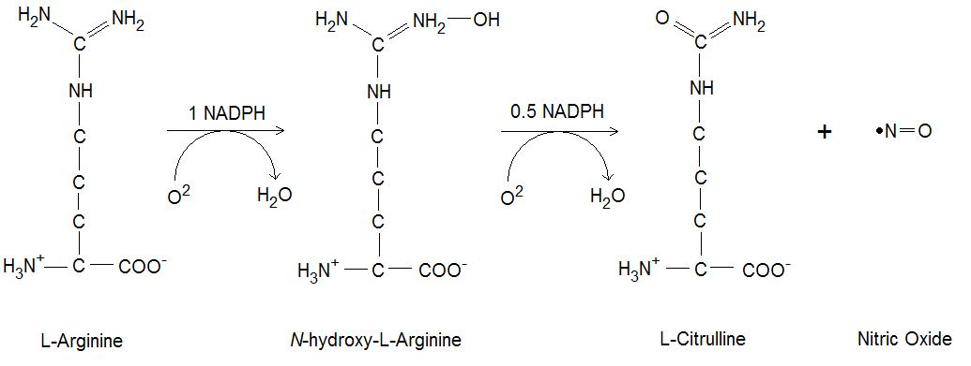
Biosynthesis of nitric oxide.

Slide 20
Biosynthesis of spermidine and spermine.
Polyamines such as spermine and spermidine, used in DNA packaging, are derived from methionine and ornithine
The first step is the decarboxylation of ornithine, a component of the urea cycle and a precursor of arginine
Ornithine decarboxylase is a PLP-requiring enzyme and is the target of several powerful inhibitors developed commercially as pharmaceutical agents

Slide 21
